Slide 1

Practical 11
Program to Build a Binary Search Tree (BST)

Slide 2

Lesson Plan
Subject/Course | Competitive Coding
Lesson Title | Write a Program to Build a Binary Search Tree (BST)
Lesson Objectives
Understand the concept of Binary Search Tree (BST) and its properties.
Learn how to insert elements into a BST.
Explore recursive and iterative insertion logic.
Analyze time and space complexity of BST creation

Slide 3
Problem Statement:
Write a program to build a Binary Search Tree (BST)
by inserting elements one by one.
The program should:
1. Accept a sequence of integer values.
2. Insert each element according to BST rules.
3. Display the tree using inorder traversal.

Slide 4
Concept
A Binary Search Tree (BST) is a binary tree where:
1. The left child has a smaller value than its parent.
2. The right child has a larger value than its parent.
3. No duplicate elements are stored.
4. Inorder traversal of a BST gives a sorted sequence.

Slide 5
Algorithm/Logic
1. Start with an empty tree (root = null).
2. For each element:
a. If the tree is empty → new node becomes root.
b. If value < root.data → insert into left subtree.
c. If value > root.data → insert into right subtree.
3. Repeat recursively until correct position is found.
4. Use inorder traversal to display the BST.
5. Inorder order: Left → Root → Right.
6. This ensures ascending order output.

Slide 6
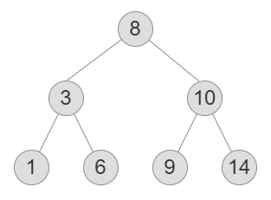
Visualization
Insert sequence: 8, 3, 10, 1,6, 9, 14
Inorder Traversal: 1,3,6,8,9,10, 14

Slide 7
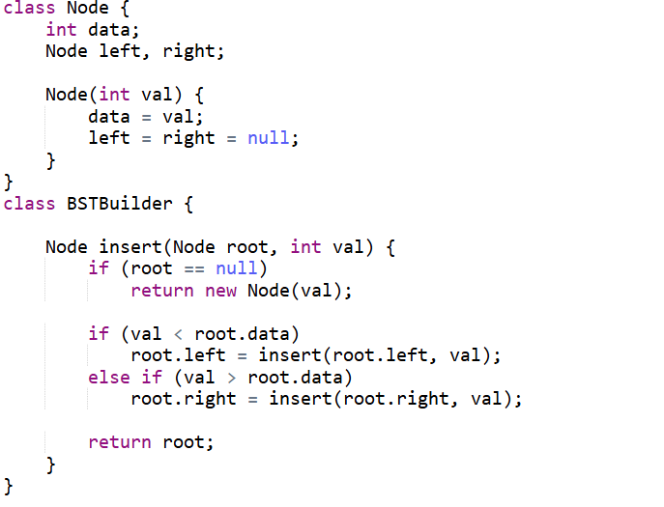
Code Implementation

Slide 8
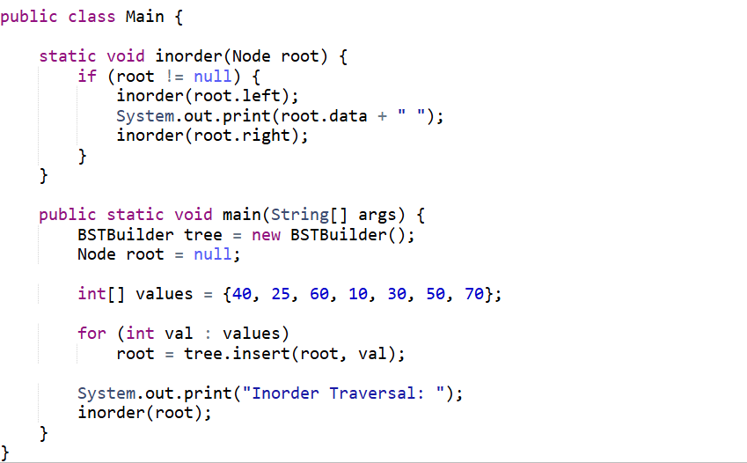

Slide 9
Output

Slide 10
Example Walkthrough
1. Insert 40 → becomes root.
2. Insert 25 → goes left of 40.
3. Insert 60 → goes right of 40.
4. Insert 10, 30, 50, 70 → placed recursively.
5. Final structure matches BST rules.

Slide 11
Time & Space Complexity
Time Complexity:
O(h) per insertion → h = height of tree.
O(n log n) average case for n elements.
Space Complexity:
O(h) due to recursion stack.

Slide 12
Summary
1. BST maintains ordered data using left and right subtrees.
2. Insertion follows comparison-based positioning.
3. Inorder traversal displays sorted elements.
4. Average complexity: O(log n), Worst case: O(n).

Slide 13
Practice Questions:
1. Insert into a Binary Search Tree— LeetCode #701
🔗 https://leetcode.com/problems/insert-into-a-binary-search-tree/
Concept: Build a BST by inserting given nodes.
Why Practice: Strengthens understanding of insertion logic.

Slide 14
Practice Questions:
2. Search in a Binary Search Tree— LeetCode #700
🔗 https://leetcode.com/problems/search-in-a-binary-search-tree/
Concept: Find an element in an existing BST.
Why Practice: Reinforces traversal and search in BST.

Slide 15
Practice Questions:
3. Construct BST from Preorder Traversal — LeetCode #1008
🔗https://leetcode.com/problems/construct-binary-search-tree-from-preorder-traversal/
Concept: Rebuild BST using preorder sequence with recursion.
Why Practice: Improves understanding of BST structure and traversal.

Slide 16
Thanks

